Slide 1
PLANTS
Uses, Form and Function
Chapter 13

Slide 2
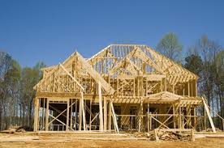
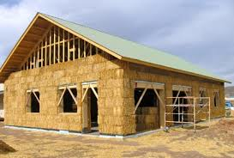
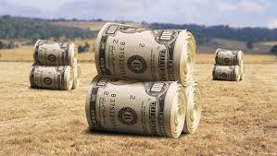
Uses
Example pg 534
Building a home: mostly wood products from trees
Alternative plant products: Straw bales used for support and insulation
Cheaper, renewable on a shorter timescale, effective

Slide 3
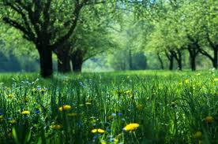
Word Wall
Photosynthesis
Cellulose
Agriculture
Food security
Sustainable agriculture
Textile
Timber
biofuel

Slide 4
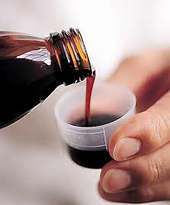
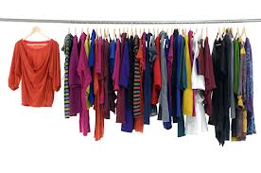
Plants as Valuable Bioresources
Humans and other organisms benefit everyday from the valuable resource of plants!
Food Medicine Oxygen Clothing Shelter
Plants most important ecosystem services are:
Photosynthesis and their Cellulose

Slide 5
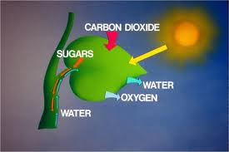
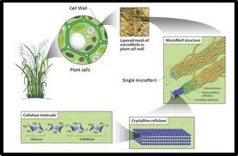
PHOTOSYNTHESIS: plants use light energy to convert water and carbon dioxide into two products vital to the biosphere: glucose and oxygen
CELLULOSE: A large carbohydrate molecule found in plant cell walls.
Cotton plants> fabric Wood Pulp>paper & cardboard
Heat generated from burning plant products

Slide 6
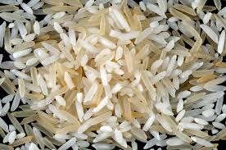
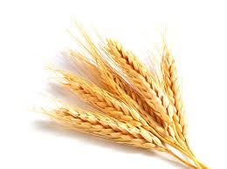
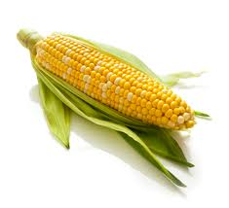
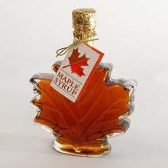
Plants as a Source of Food
Historically, plants have been a primary food source for humans
Today, 60 % of human caloric consumption that is directly from plants, comes from three crops: WHEAT, RICE & CORN
Other important crops: sugar cane, potatoes, sugar beets, soybeans and barley
In addition to food, Canadian crops provide jobs and valuable exports. Ex/ maple sugar/syrup worth over $ 200 million each year

Slide 7
Important crops to Canada
Crop | Production (K’s of tonnes) | Food Products
Wheat | 28 611 | Flour for pasta, bread, cereal, cakes, cookies
Canola | 12 642 | Canola oil
Barley | 11 781 | Can be added to soups, salads. Flour for baking
Crain corn | 10 592 | Cornmeal, cereal, tortilla chips
Oats | 4 272 | Oatmeal, oat bran. Flour
Soybeans | 3 335 | Soybeans, tofu, soy milk, flour
Lentils | 1 043 | Eaten alone or added to …
Flaxseed | 861 | Flaxseed, flaxseed oil

Slide 8
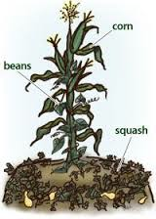
Aboriginal Agriculture
Corn Climbing Beans Squash
“The three sisters”
Planted together in N.A. for thousands of years:
Corn acts has a vertical structure for the beans to climb
When bean plant dies & decays, it adds nitrogen to the soil in a form for both corn and squash to use
The squash growing along ground, acts as a ground cover

Slide 9
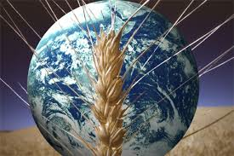
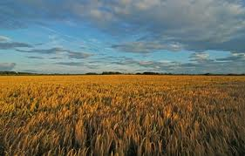
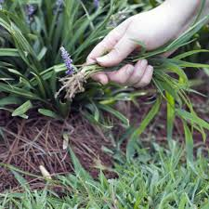
Food Security
Scientists predict by 2030, population will rise to over 8 billion.
Can earth sustain this many people? Enough food?
Monoculture: Increases food yields because easier to maintain BUT, this method depletes soil nutrients. Therefore synthetic fertilizers are required and pesticides are required to avoid crop-specific pests.
Sustainable Agriculture: The goal is to produce enough food to feed the world while considering the economy, society, and the environment.

Slide 10
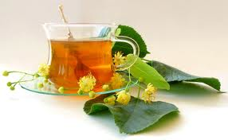
Plants as a Source of Biochemicals
Medicinal Uses : Then & Now
Aboriginals have been doing this for years
Ex/ tea from blackberry plants used for stomach ailments
When European explorers arrived in N.A. with scurvy (Vitamin C deficiency) aboriginals made tea using Evergreen bark and needles
Today approximately 25% of all prescription medicines contain plant extracts
The deforestation of rainforests threatens the loss of undiscovered species that could cure conditions

Slide 11
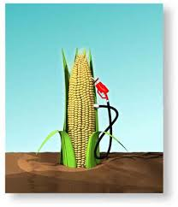
Plants as a Source of Fuel
Then & Now
Burning wood and parts of plant for warmth and cooking
Burning Coal (prehistoric plants from millions of yrs ago)
Canada is becoming a leader in the production of BIOFUELS: fuels produced from renewable biological sources such as crops and crop residues.
Ex. CORN > ETHANOL

Slide 12
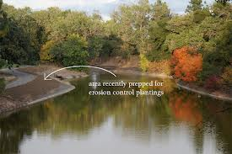
Plants and Erosion Control
Plants play a key role in controlling erosion and reducing the negative effects of flooding.
Soil loss is caused by wind and water removing the top layers of the soil.

Slide 13
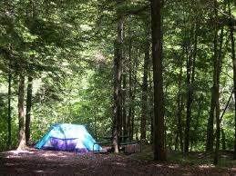
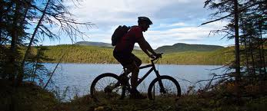
Recreation & Ecotourism
Camping, hiking boating, picnicking, cycling and climbing
Parks, forests, backyards: Exercise, learn about nature and relax
Tourists come to Canada to visit our landscapes ex/temperate rainforests (west coast), prairies, boreal forests
Cosa Rica has tropical rainforests, South America has jungles, and Africa has wild grasslands.

